Slide 1


SMART INDIA HACKATHON 2025
TITLE PAGE
Problem Statement ID –SIH25044
Problem Statement-AI-Powered Crop Yield Prediction and Optimization
Theme-Agriculture,Foodtech&Rural Devlopement
PS Category- Software
Team ID-83032
Team Name- Kisan Sarthi

Slide 2





















IDEA TITLE
Kisan Sarthi
System Architecture
Proposed Solution:
Client Req/res
Data Retrieval
AI-powered Yield Prediction – Regression + Neural Net models forecast yield with high accuracy, reducing uncertainty
Smart Crop Recommendation – Suggests the most suitable crops by analyzing soil NPK, soil type, weather, and water resources.
Resource Optimization Engine – Provides personalized irrigation, fertilizer, and pesticide schedules to minimize cost and maximize yield.
AI Disease & Pest Detection – Farmers upload images of affected crops; the system diagnoses problems and suggests remedies instantly.
Personalized Farming Calendar – Auto-updated schedules for irrigation, fertilizers, and pesticides tailored to each farmer’s land and crop.
Chatbot Advisor – A 24/7 virtual Krishi assistant providing answers in commonly used languages.
Sustainability Insights – Tracks water saved, fertilizer reduced, and carbon footprint to promote eco-friendly farming practices.
Authentication
Server Req/Res
Web-App
Server
Cloud Services
Email Services
Auth Service
Web Analytics
Weather API
Image
Recognition API
Translation/Chatbot API
Upload crop images
View predictions
Get alerts
Enter soil details
Oversee system
Validate data
Generate policy insights.
Manage database server
APIs
Farmers
Govt. Admins
System Admin
Functional Modules
• Crop Recommendation Module • Yield Prediction Module • Resource Optimization Engine
• Disease & Pest Detection
• Personalized Farming Calendar • Alerts & Notifications • Sustainability Tracking • Chatbot Advisor

Slide 3





















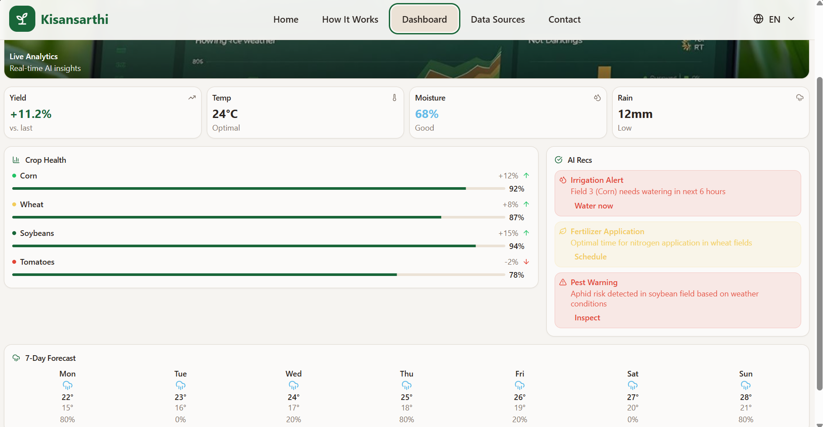
TECHNICAL APPROACH
Kisan Sarthi
Historical crop data(From Govt Database)
Frontend Website interface
Tech Stack:​
Real time weather data
Feedback and reviews from farmers
Front-end:
Database
Real time soil health metrics(IOT sensors and regular lab reports)
Displaying Results
Back-end:
AI/Ml:
Making them answer a questionnaire for additional information
Other:
Cloud:
Data Processor
(Data cleaning, data normalization and feature engineering)
Selection of region manually /GPS
Server
Selection of Language
Login Credentials
Processed Data
Machine learning layer
Recommended Measures and steps to be followed for optimum result
Model selection
Training
Validation
Prediction

Slide 4




FEASIBILITY AND VIABILITY
Kisan Sarthi
Technical :
Operational :
Feasibility: Proven tech—scalable via cloud + edge computing.
Risks: Accuracy in AI detection, scheduling reliability, offline support.
Solutions: Regional AI datasets, weather/soil APIs, lightweight offline modules.
Feasibility: Practical with phased deployment + personalized engagement.
Risks: Low adoption due to digital literacy/connectivity.
Solutions: Multi-language chatbot, simple UI, farmer training, offline access.
Legal / Regulatory :
Financial :
Feasibility: Viable—ROI through yield gains + policy support.
Risks: High AI/dev costs
Solutions: Open-source tools, govt. cloud credits, phased rollout.
Feasibility: Legally sound—aligns with govt. digital agriculture goals.
Risks: Data protection, compliance with MSP/market laws.
Solutions: Encryption, DPDP/IT law compliance, MSP-aligned crop advice.

Slide 5








IMPACT AND BENEFITS
Kisan Sarthi
Increased Productivity & Profitability
AI-Powered Pest & Disease Control
Multi-Language Accessibility
Smarter Farm Management
Data-driven recommendations help farmers increase yield by at least 10%, optimize input use, and maximize profitability.
Regional language support + chatbot ensures inclusivity, empowering farmers with limited digital literacy.
Farmers can upload leaf/stem images for instant diagnosis and remedy suggestions, reducing crop losses.
Personalized farming calendar + real-time alerts (irrigation, pests, weather) ensure timely, efficient decision-making.
Cost Savings through Efficiency
Sustainability & Eco-Friendly Practices
Risk-Adjusted Crop Planning
Farmer Community & Expert Connect (future scope)
Cost-benefit calculator helps compare inputs vs. yield; smart scheduling minimizes wastage of water, fertilizer, and pesticides.
Tracks water saved, reduced fertilizer use, and carbon footprint, promoting climate-smart farming.
Suggests crops based on soil, weather, market demand, and MSPs, reducing farmer risk and improving income stability.
Enables knowledge sharing among farmers and direct access to agri-experts for continuous improvement.

Slide 6
RESEARCH AND REFERENCES
Kisan Sarthi
References:
Comparison with existing systems:
Existing Agri-Tech Platforms:
  CropAIQ
  Kisan Samadhan
  Kisan AI​
  Hybrid Deep Learning Models in Agriculture:
  IEEE, Springer (Research Articles)
Research & Best Practices:
  AI in Agriculture
  Machine Learning for Crop Yield Prediction
  Pest/Disease Detection using Deep Learning
  Precision Agriculture and IoT
Feasibility Facts:
  ICAR (Indian Council of Agricultural Research) Reports
  FAO (Food and Agriculture Organization) Crop Statistics
  IMD (India Meteorological Department) Weather API
  Govt. of Odisha – Department of Electronics & IT
Feature | Our Model | CropAIQ | Kisan Samadhan | Kisan AI | Hybrid DL Models
Yield Prediction
AI Pest/Disease Detection |  |  |  | (Partial)
Personalized Scheduling (Calendar)
Real-time Alerts/Notifications
Multi-language Support
Offline / Low-data Mode
Cost-benefit Calculator
Sustainability Insights
Risk-adjusted Crop Suggestions (Market + MSP)
Chatbot Advisor (Voice + Text) |  |  | (Text) | (Text) | (Text)
Farmer Community / Expert Connect | (Future Scope) |  | (Call center support)

